Slide 1

Outpatient and remote healthcare monitoring
Ashmika Lakhotiya
NUID - 001621193

Slide 2
Problem Statement
Several people in the world suffer with health problems because they don’t have ready access to effective health monitoring system. People living in remote areas don’t have easy access to healthcare centers. Aged patients find it challenging to visit hospital and medical store regularly. As well as for common people it is difficult to visit hospitals regularly because of the busy schedule , taking appointments , travelling to the hospital etc. These are the challenges one needs to address for providing better health facilities to the people.

Slide 3
Proposed Solution
Quality of health of people can be improved by providing easy access to the health organizations. Sensors connected through the Internet of Things can make it possible for monitoring these patients even if they are residing in remote areas. We can account patient’s health data from sensors and share it with medical professionals.
In my project , when the patient is discharged from the hospital , a monitoring device is given to the patient and with the help of application the patient is in touch with doctors , lab assistants and pharmacy.

Slide 4
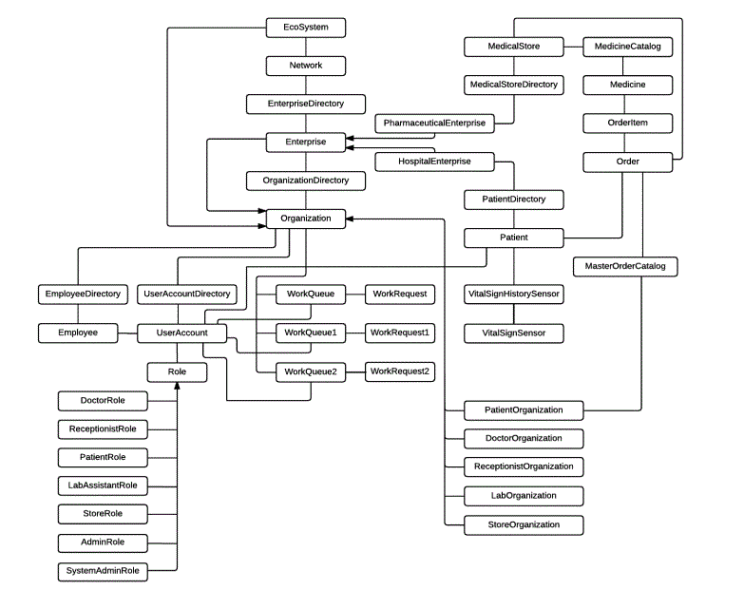
Object Model

Slide 5
Roles , Responsibilities and their Features - Receptionist Role
Receptionist creates the account of the patient and assigns the doctor attending him.
Registers the patient by giving them username and password.
She/he can update patient details .

Slide 6
Patient Role
When patient logs in the system , firstly vital signs are generated by the sensors attached to application and vital signs with abnormal status are automatically routed to the Lab Organization.
Patient can send request to doctor , if she/he is not feeling well and doctor can prescribe medicines and suggest corrective actions to be taken.
Patient can select the store in his/her network and can order the medicine.

Slide 7
Patient Role
Patient can view the orders and their estimated delivery specified when store accepts the request.
Patient can view its current vital sign generated at the time of log in . Vital signs generated earlier can also been seen. Patient can view the graph of vital signs .
Results provided for abnormal vital sign can be seen as well with corrective actions to be taken after Lab Assistant processes the request.

Slide 8
Doctor Role
Doctor can view the request sent by the patients assigned to him .
He can prescribe the medicines for the request and suggest correct actions to be taken.

Slide 9
Lab Assistant Role
Lab Assistant can view all the requests sent by sensors for the patients whose abnormal vital sign is generated.
He can assign the request to him and process it .
He can give the suggestions by analyzing the reason for abnormality.

Slide 10
Store Role
Store head can add the medicines to the store.
Store head can view the catalog of the store.
Store head can view the orders requested by the patients of its network and based on the address can specify the estimated delivery time to the patient.

Slide 11
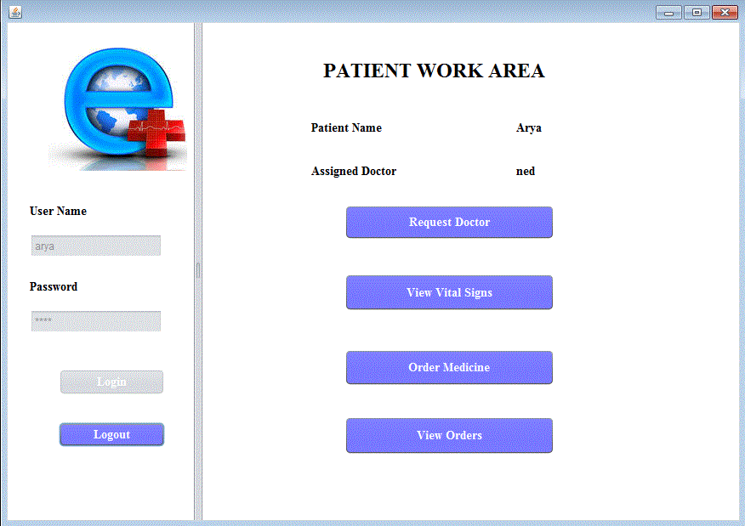
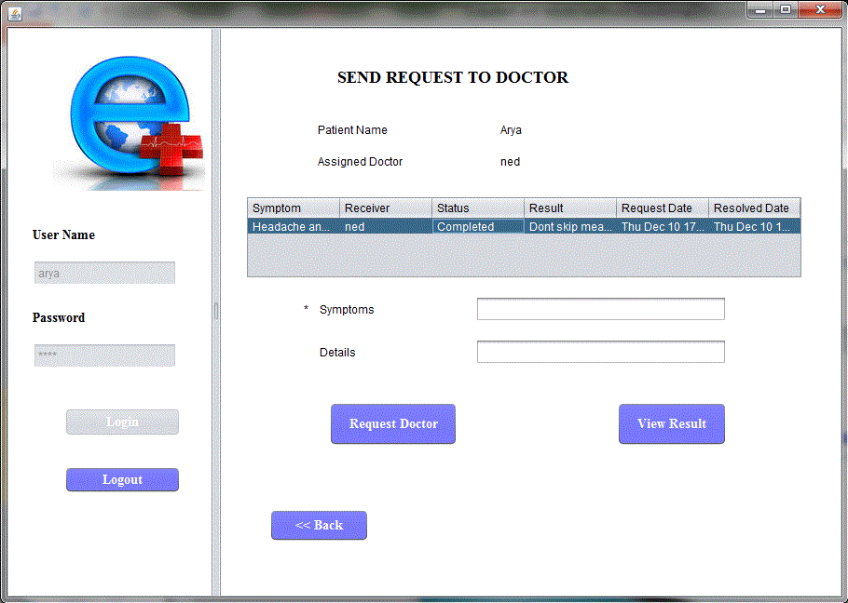
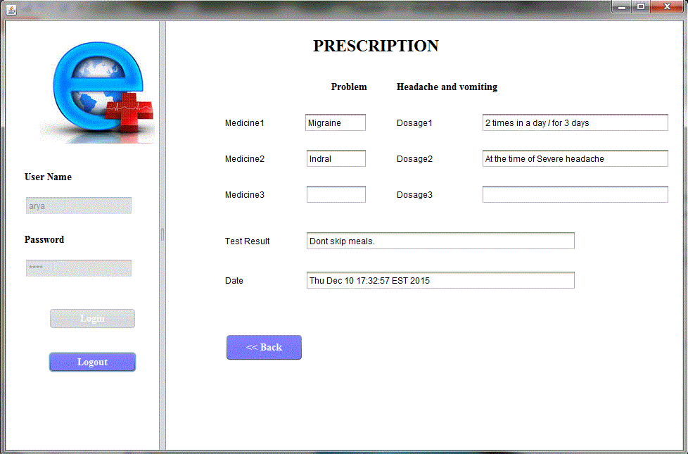
Patient Work Area
Patient sends request to the doctor and views the prescription for the completed request.

Slide 12
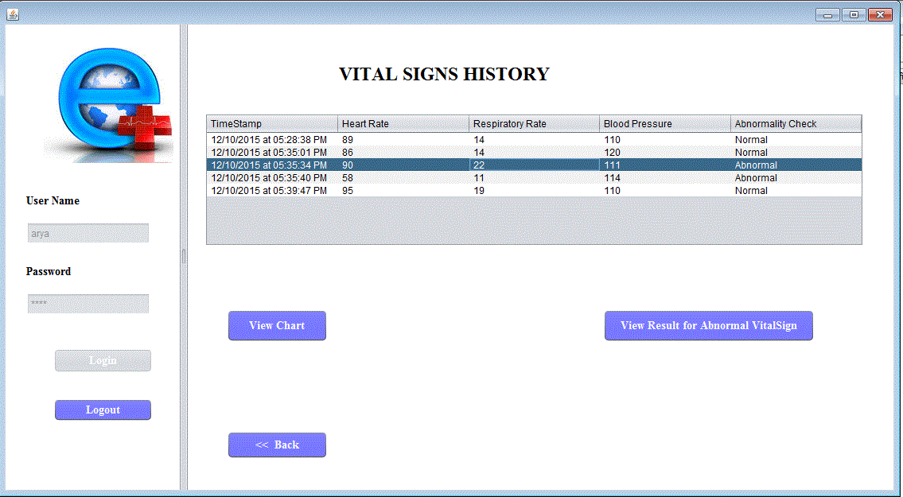
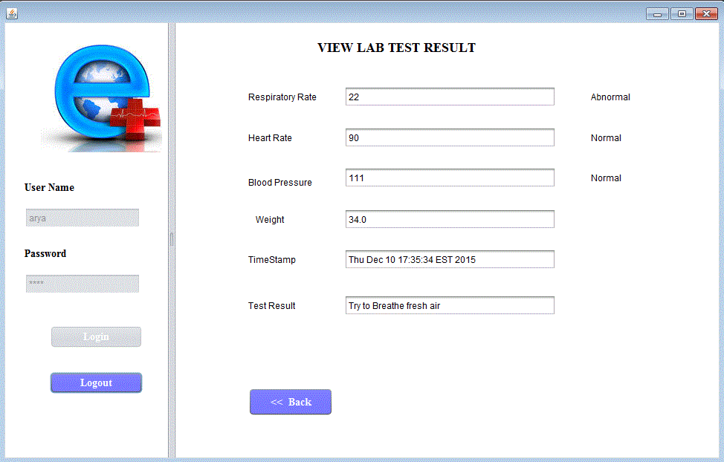
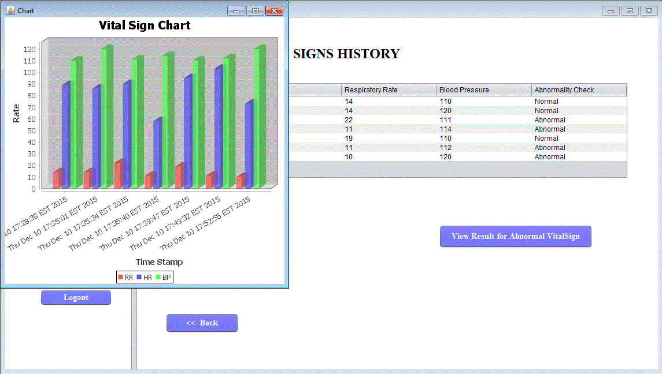
Patient Work Area
Patient logs in the application and vital signs are automatically generated. Vital Sign with abnormal status are reported to Lab Organization. Patient also views the graph of vital signs generated.

Slide 13
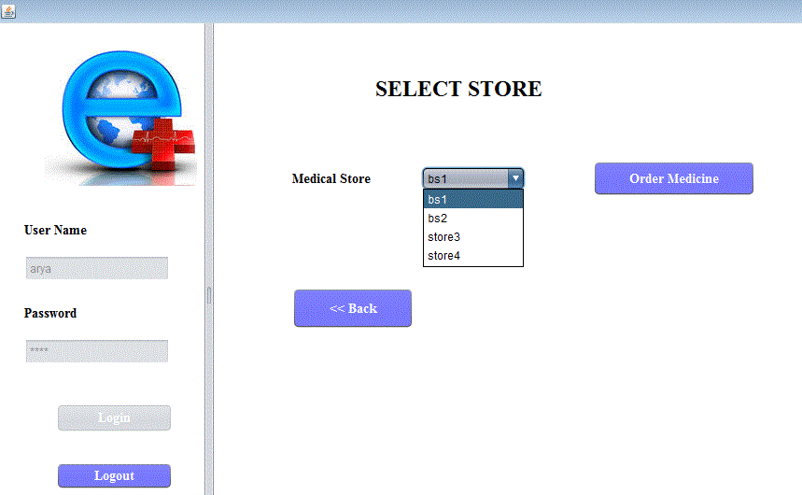
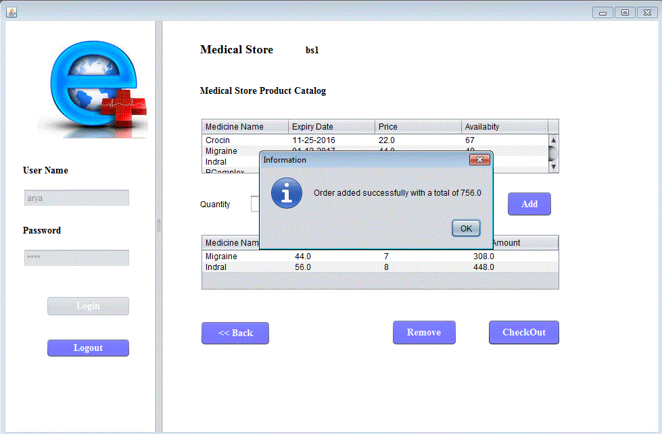
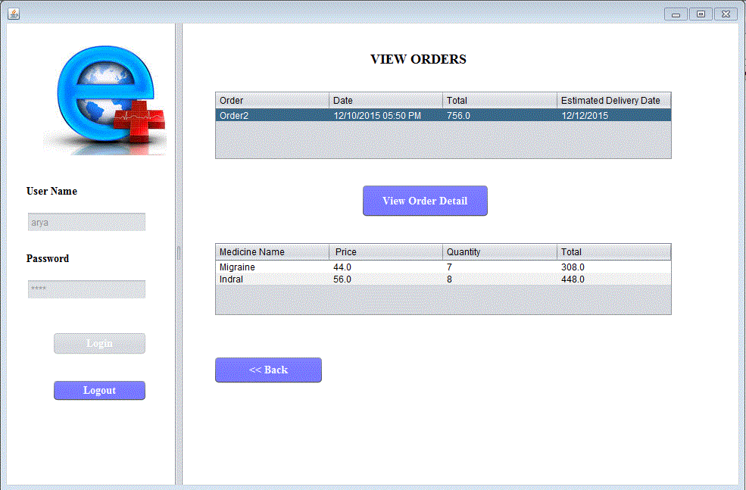
Patient Work Area
Patient selects store and orders medicine.
Estimated delivery can be seen when store accepts the order request

Slide 14
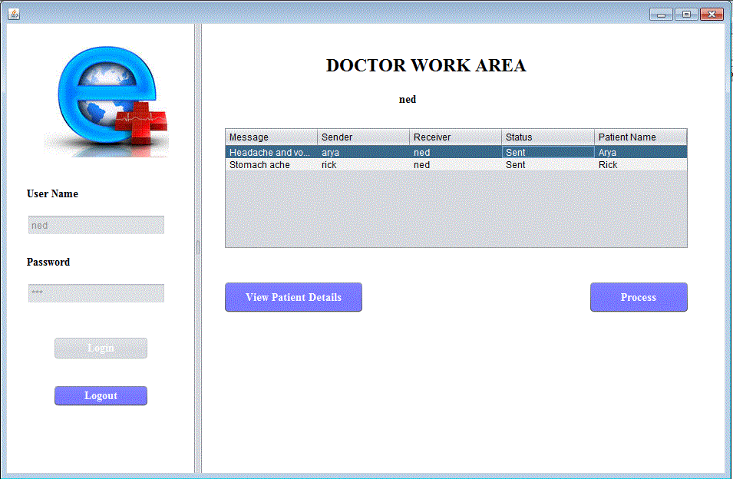
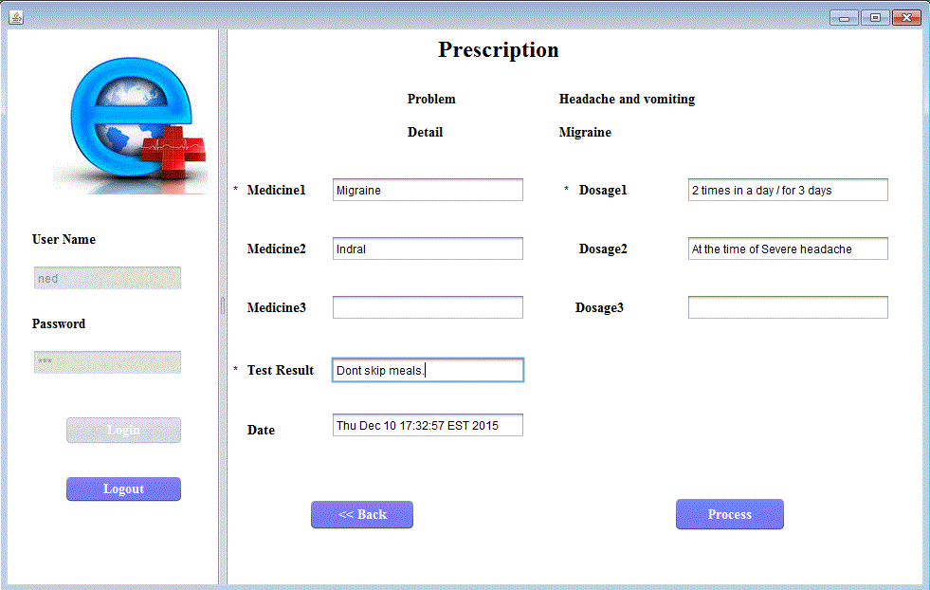
Doctor Work Area
Doctor views the requests of patients assigned to him and prescribes the medicines.

Slide 15
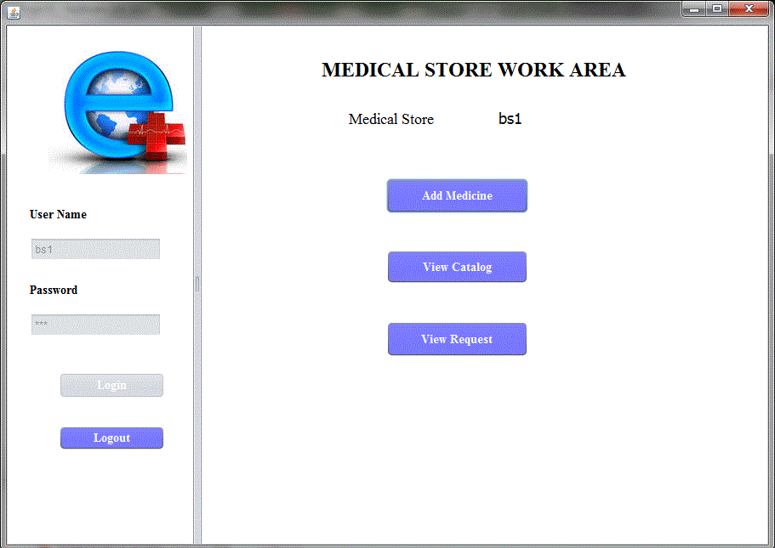
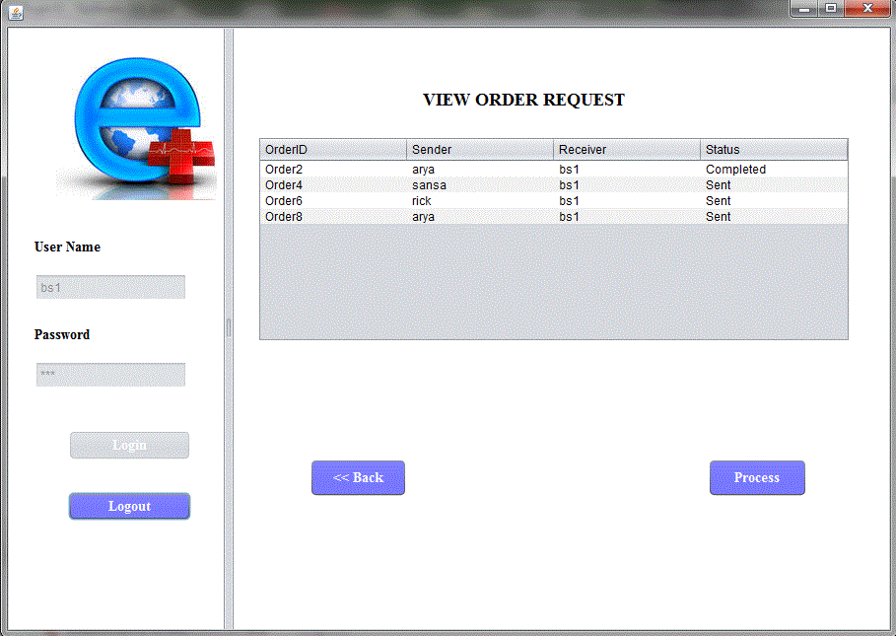
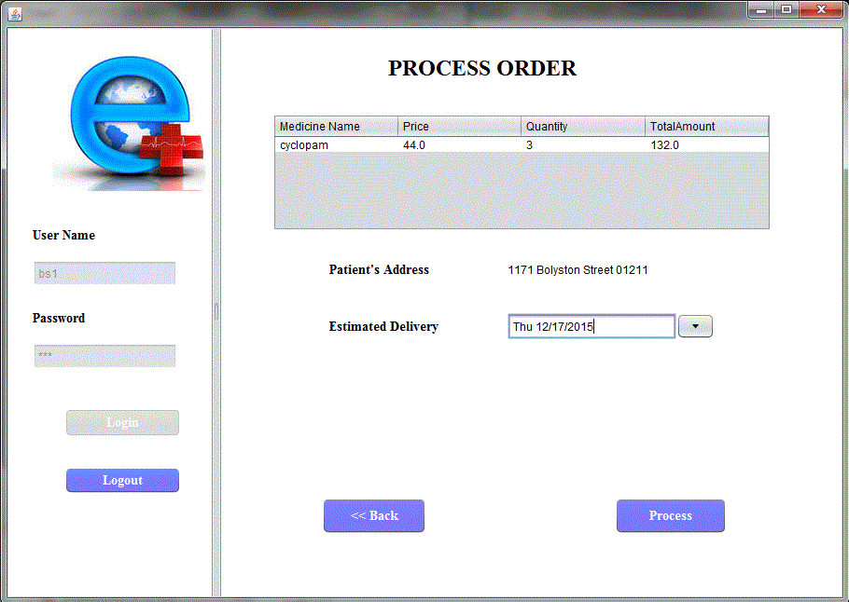
Store Work Area
Store head views the order requests of the patients and specifies the estimated delivery time.

Slide 16
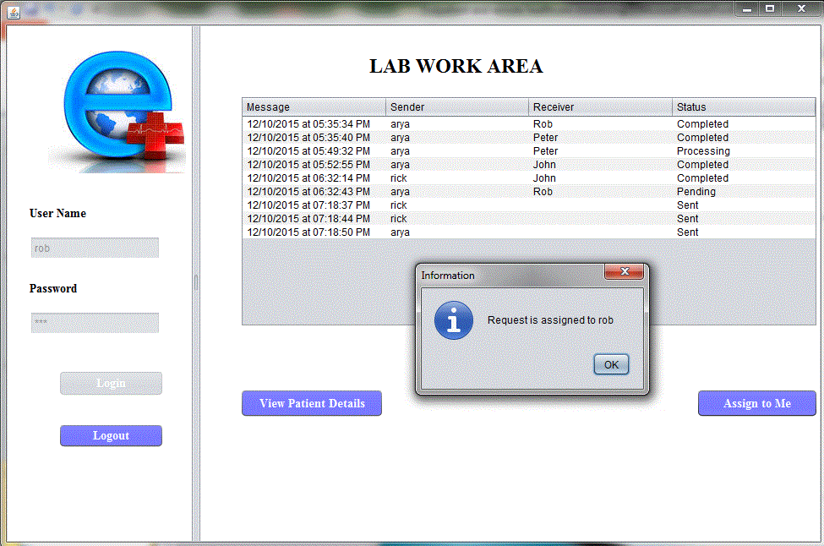
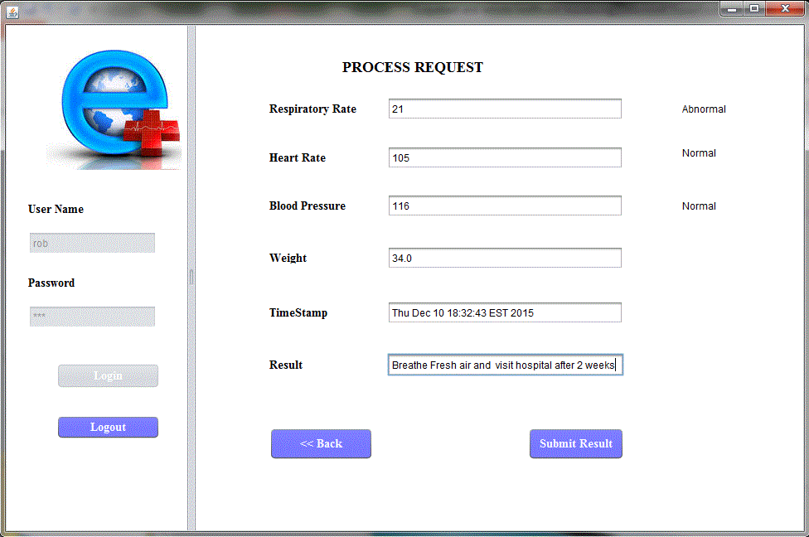
Lab Work Area
Lab Assistant views the vital signs with abnormal status, generated by sensors and suggests corrective measures after processing.

Slide 17
Conclusion
Through the application people will have easy access to hospitals and pharmaceutical stores . They will be available just a click away.
No matter how busy one is , he/she can take care of their health as well as your near and dear ones by logging into application.

Slide 18

Thank You

